Slide 1

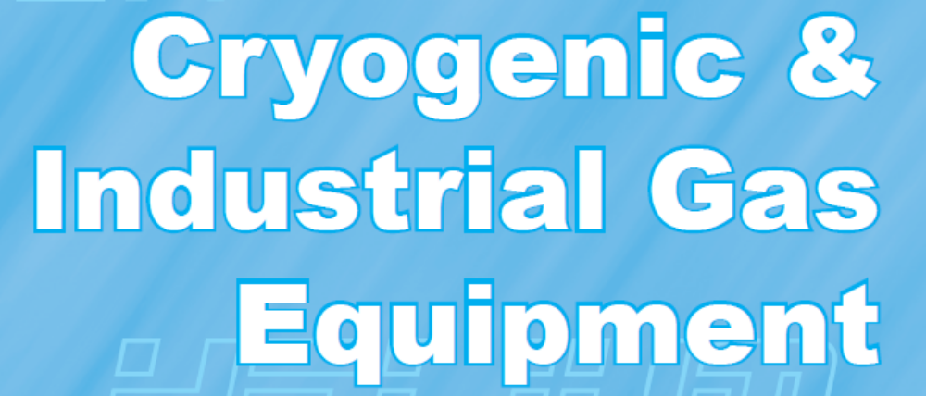





Slide 2


World Wide Leader as
Manufacture
of
LPG-NH³-Cryogenic-LNG Equipment

Slide 3
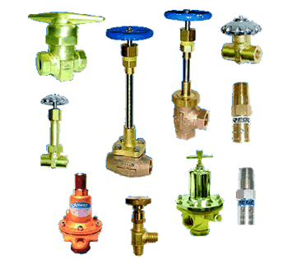
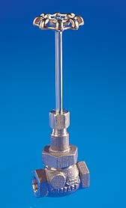
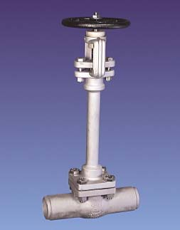
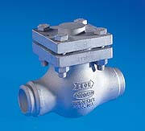
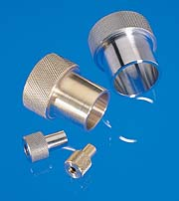

Slide 4
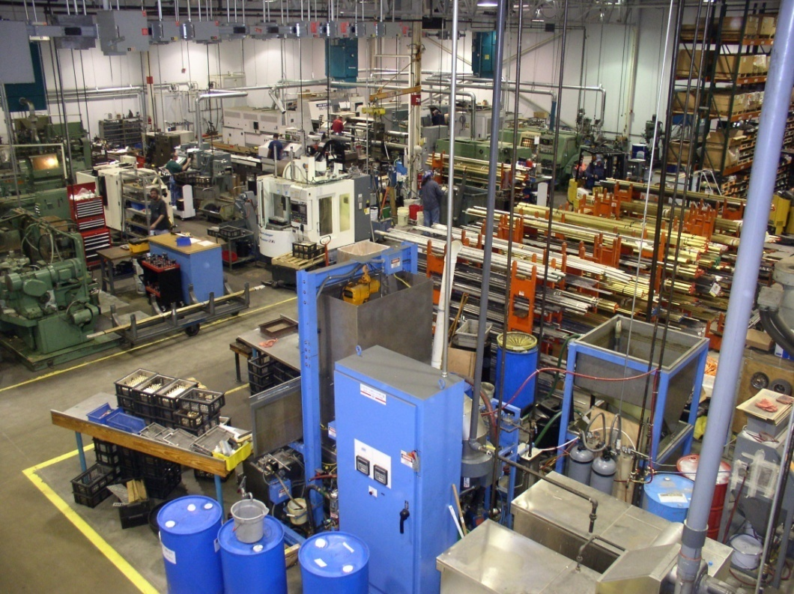
RegO Cryo-Flow
  RegO Starts in 1998 a new Factory for manufacturing Cryogenic Equipment
RegO Cryo-Flow takes over the Cryogenic Manufacture Goddard which was based in Massachusetts

Slide 5
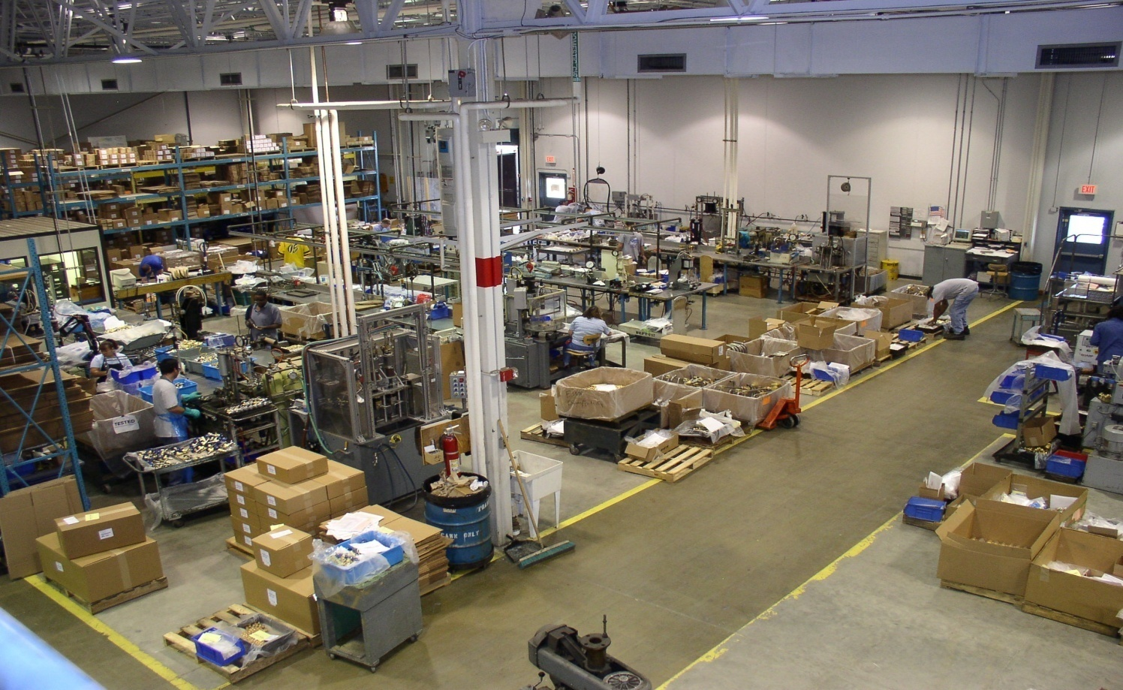
RegO Cryo-Flow

Slide 6
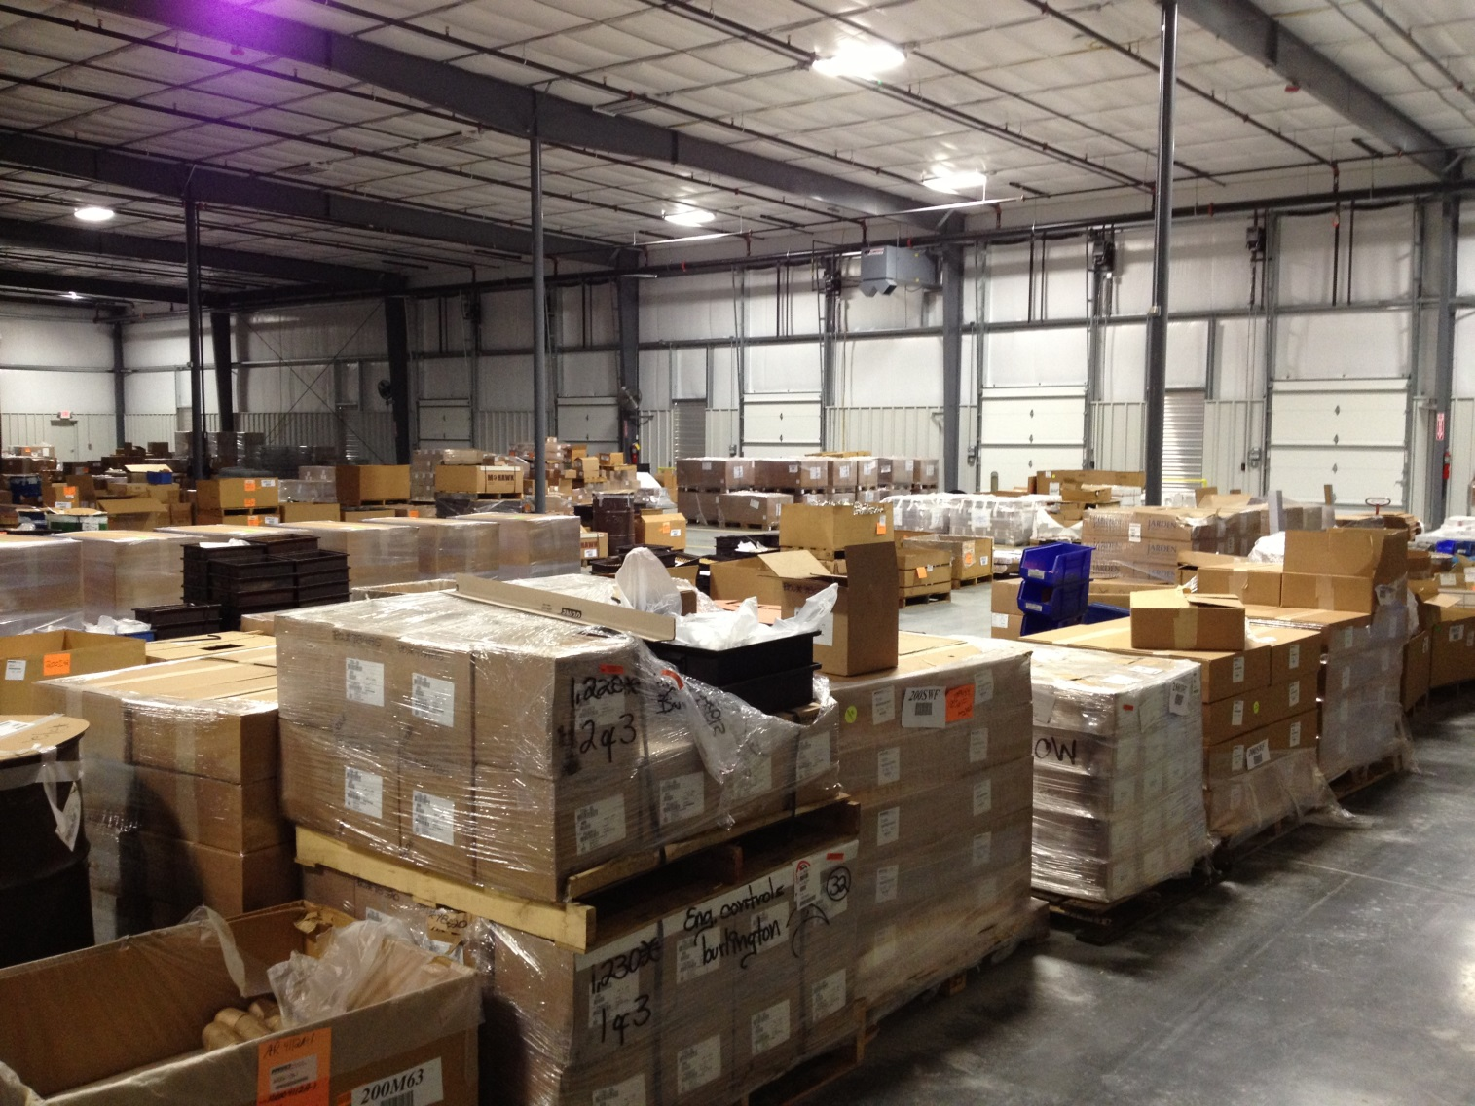
RegO Cryo-Flow

Slide 7
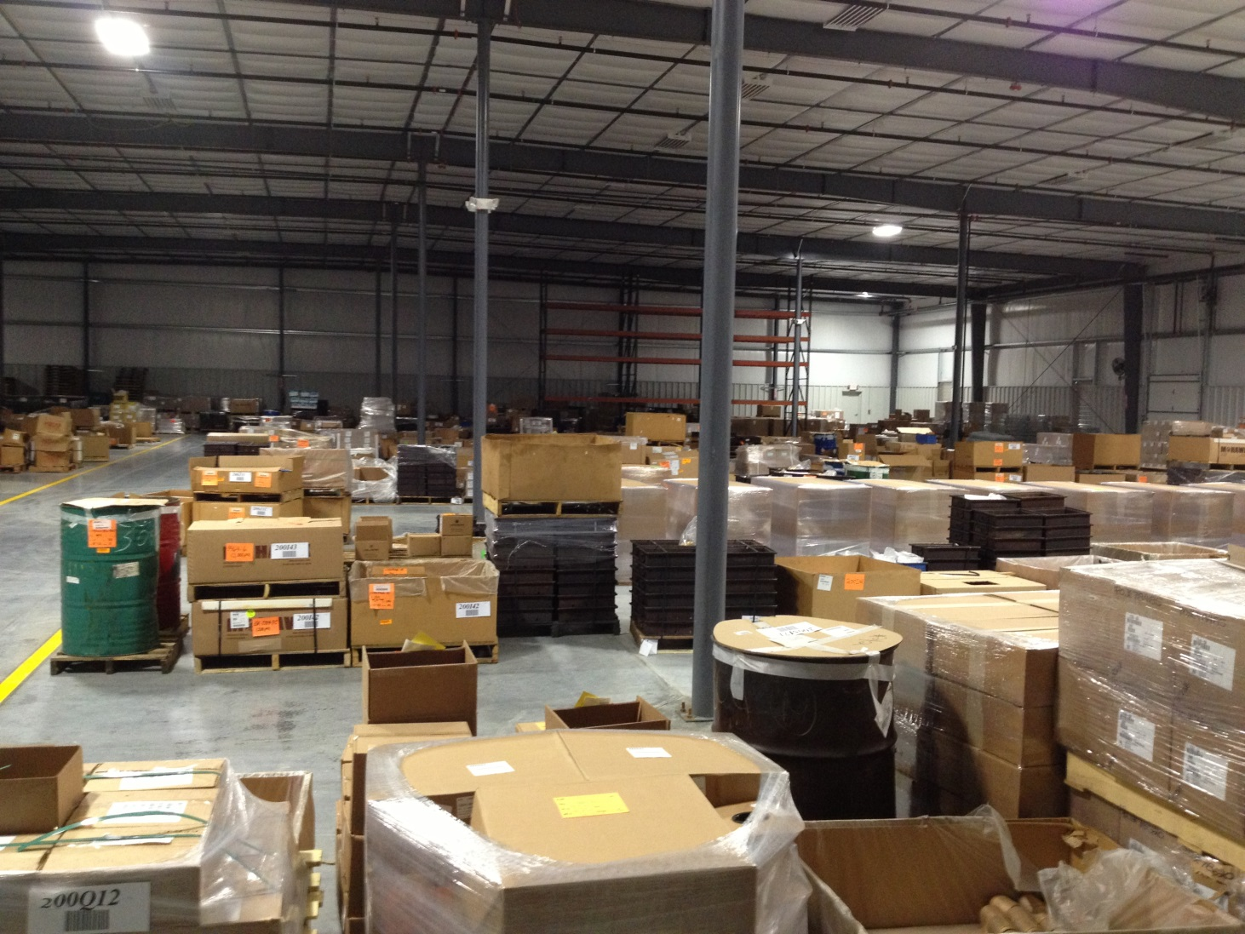
RegO Cryo-Flow

Slide 8
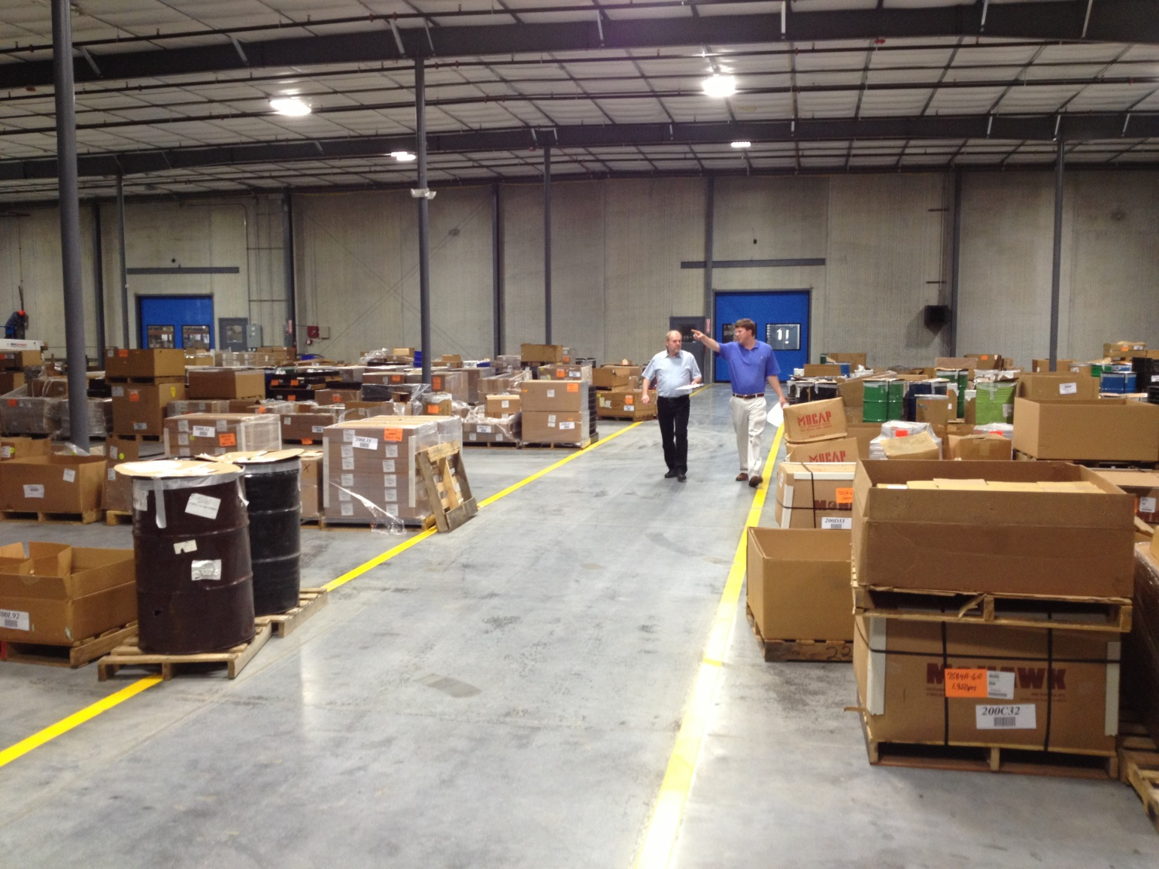
RegO Cryo-Flow

Slide 9



Slide 10

Defined as:
Producing very low Temperatures

Slide 11

By liquidizing air, Dr. Karl von Linde created the preconditions for the production of oxygen in 1895 In Germany.
With air liquefaction, Dr. Karl von Linde created the conditions needed to produce pure gases using low-temperature processes. These gases include not only oxygen and nitrogen, but also hydrogen and inert gases – a technology for which the future at that time just begun.
Cryogenic compressed gases are used today world wide in all Industries.

Slide 12

Air is a mixture of gases, 78% nitrogen and 21% oxygen with traces of water vapor, carbon dioxide, argon, and various other components.
78,09 % Nitrogen (N²)
20,95 % Oxygen (O²)
0,93 % Argon (Ar)
0,03 % Carbon Dioxide (CO2
Other components are Helium (He) und Neon (Ne)

Slide 13

Production of steel
Production of glass
Production of mineral wool
Casting of steel &other metals
Production of Aluminium
Welding and cutting steel
Production of paper
Fire protection
Oil production
Treatment of water
Fish Farming
Food processing
Wine production
Plant cultivation under glass
Medical purposes

Slide 14

Nitrogen gas has a wide variety of applications
To preserve the freshness of packaged or bulk foods
The production of electronic parts such as transistors, diodes, and integrated circuits
Dried and pressurized, as a dielectric gas for high voltage equipment
The manufacturing of stainless steel
Use in military aircraft fuel systems to reduce fire hazard.
Filling automotive and aircraft tires[4] due to its inertness and lack of moisture or oxidative qualities.
as an inexpensive alternative to argon

Slide 15

Nitrogen, N² -195 °C , Refrigerations systems, cryo-surgery
Oxygen, O² -182 °C , Steel cutting and welding, Rocket fuel
Carbon Dioxide, CO² - 78°C , Fire fighting, Drink dispending,
Cryo surgery, refrigeration
Argon, Ar, -185 °C , Lighting
Hydrogen, H² -252 °C , Metal production, Rocket propellant
Helium, He – -268 °C, Air Ballooning, Welding,

Slide 16

1 Liter liquified Oxygen gives 862 Liter vapourized Oxygen.
1 Liter Liquified Nitrogen gives 697 Liter vapourized Nitrogen.
Liquified gases are always stored in double isolated Cylinders or Tanks.

Slide 17

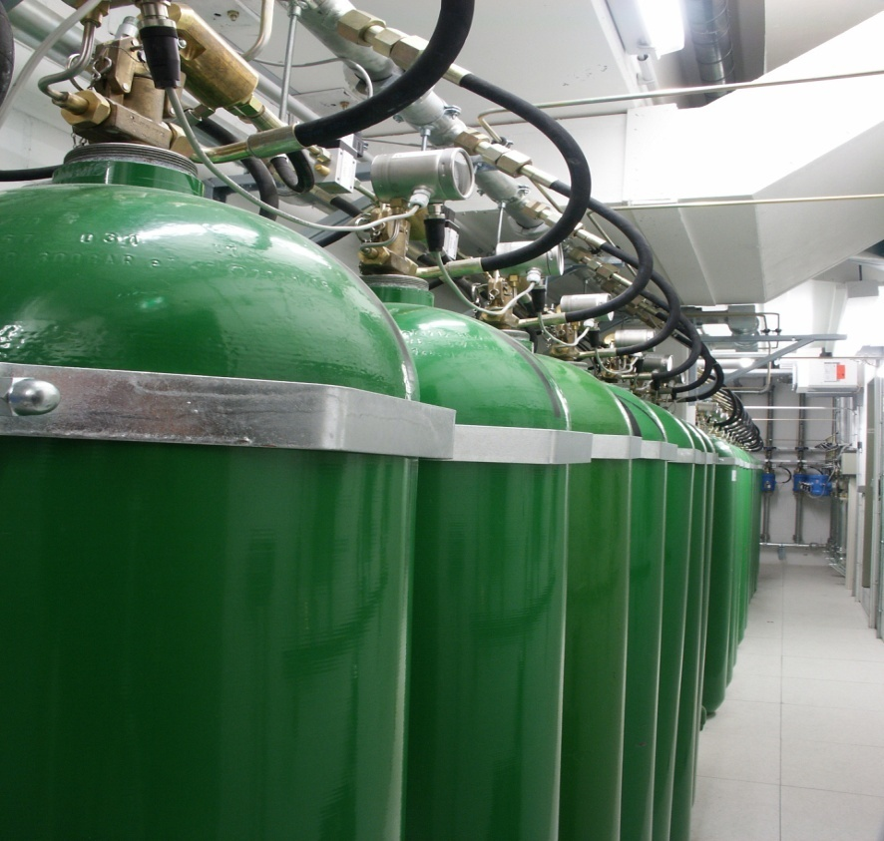
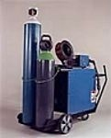


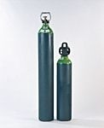

Slide 18

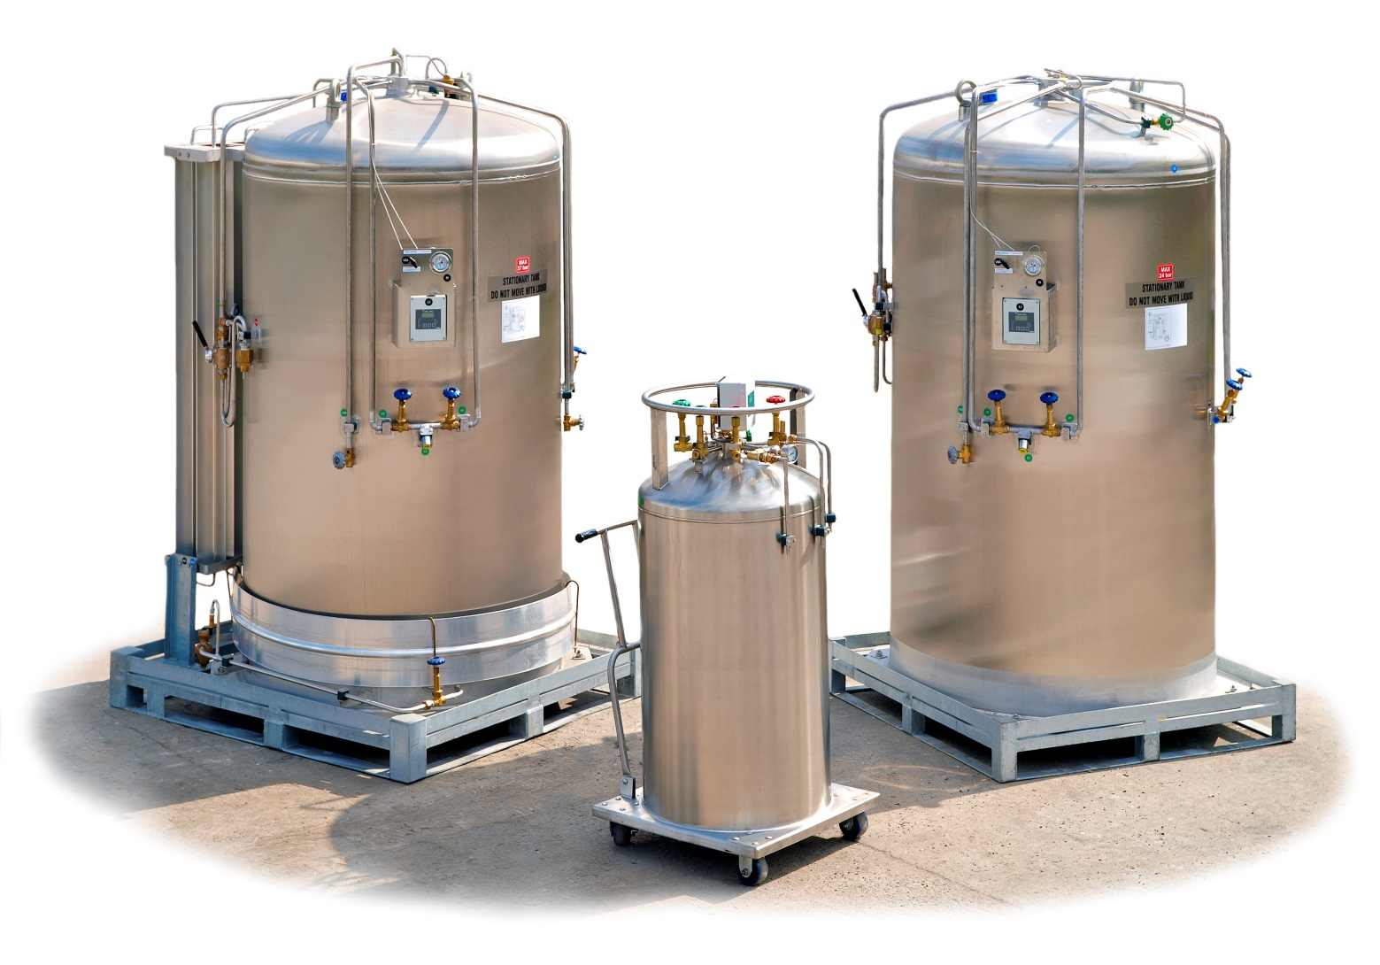

Slide 19

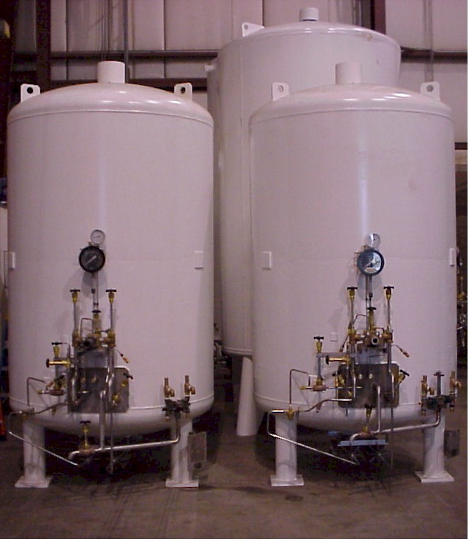
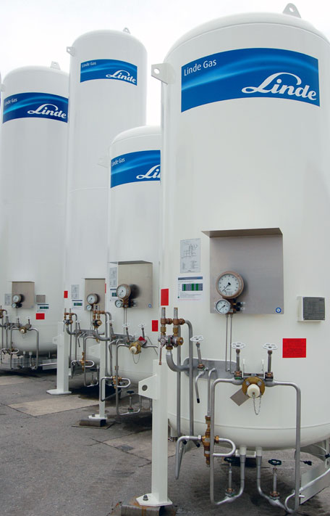

Slide 20
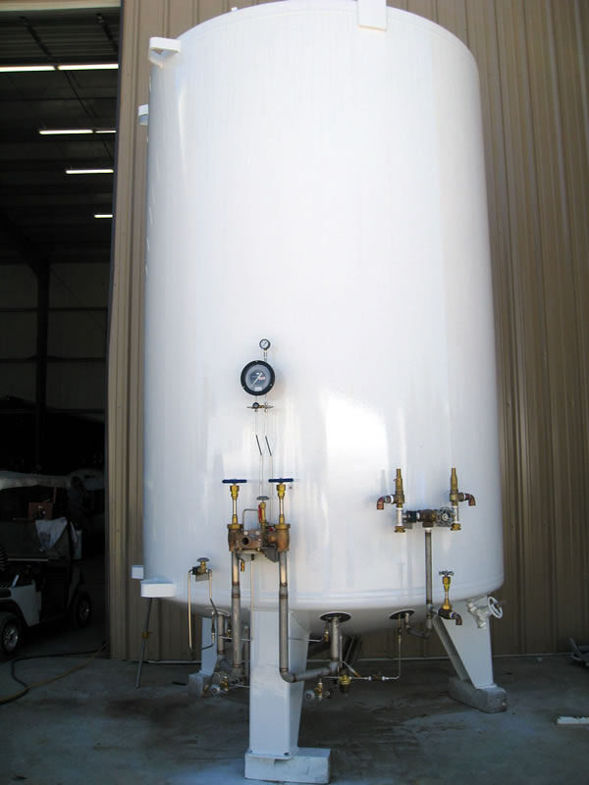
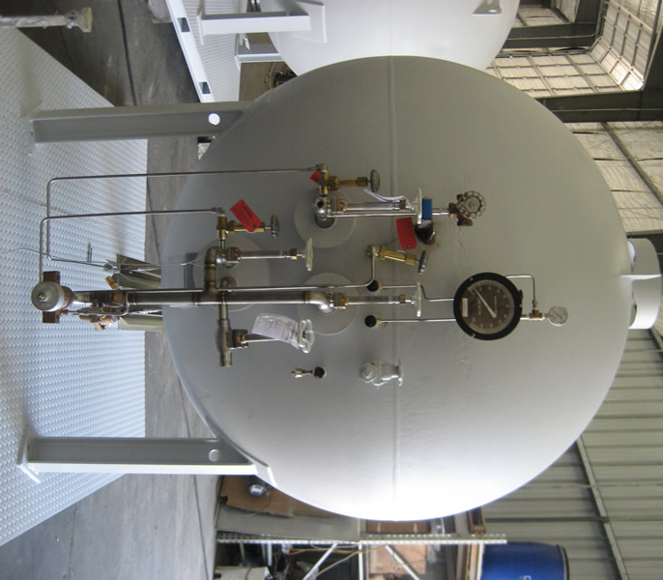

Slide 21

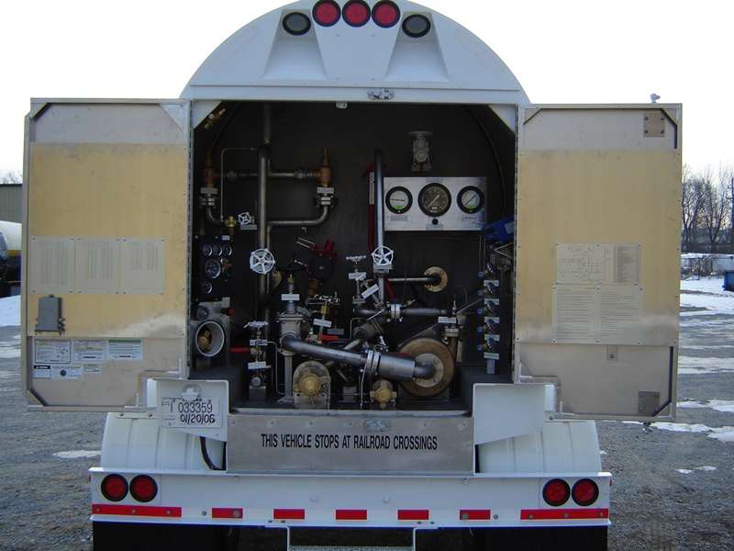
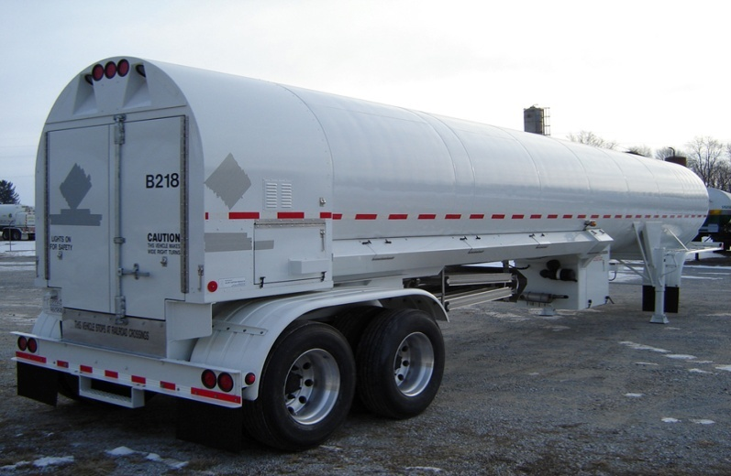
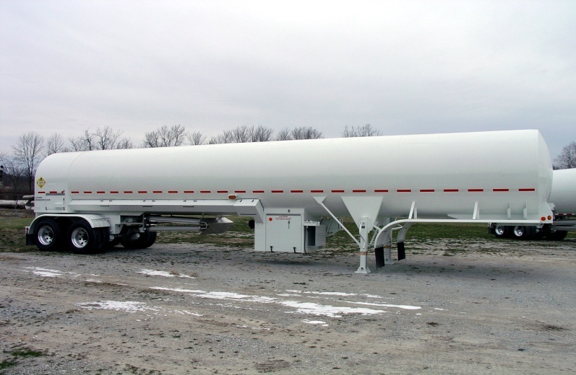
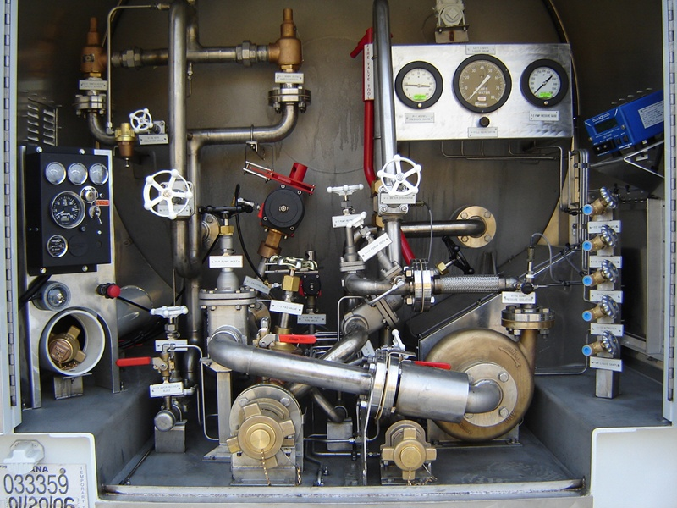

Slide 22

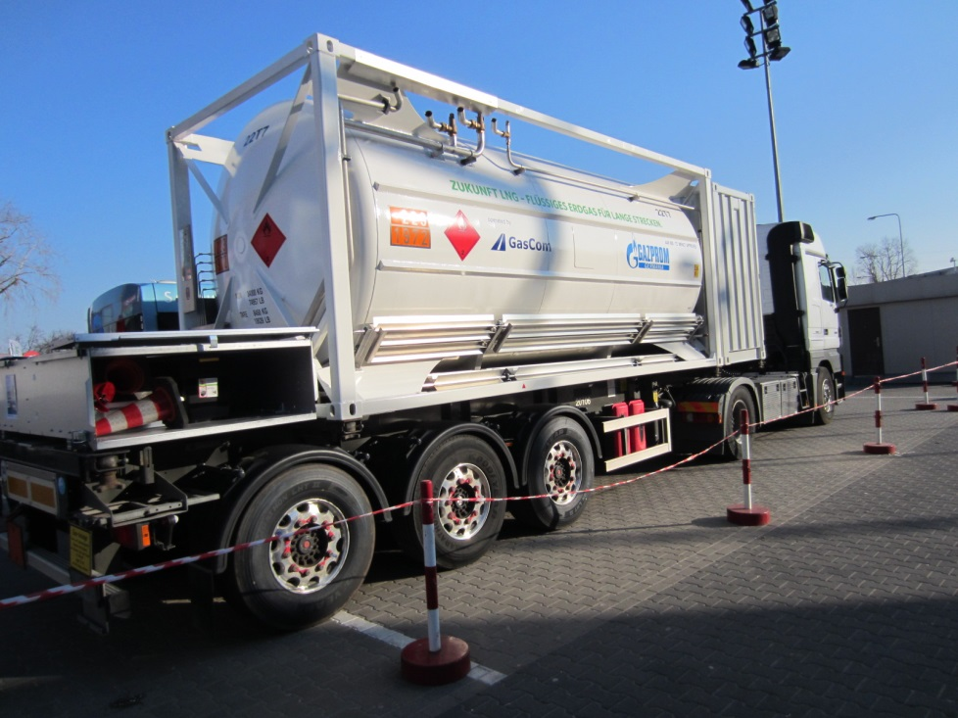
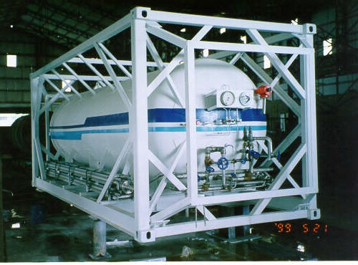

Slide 23

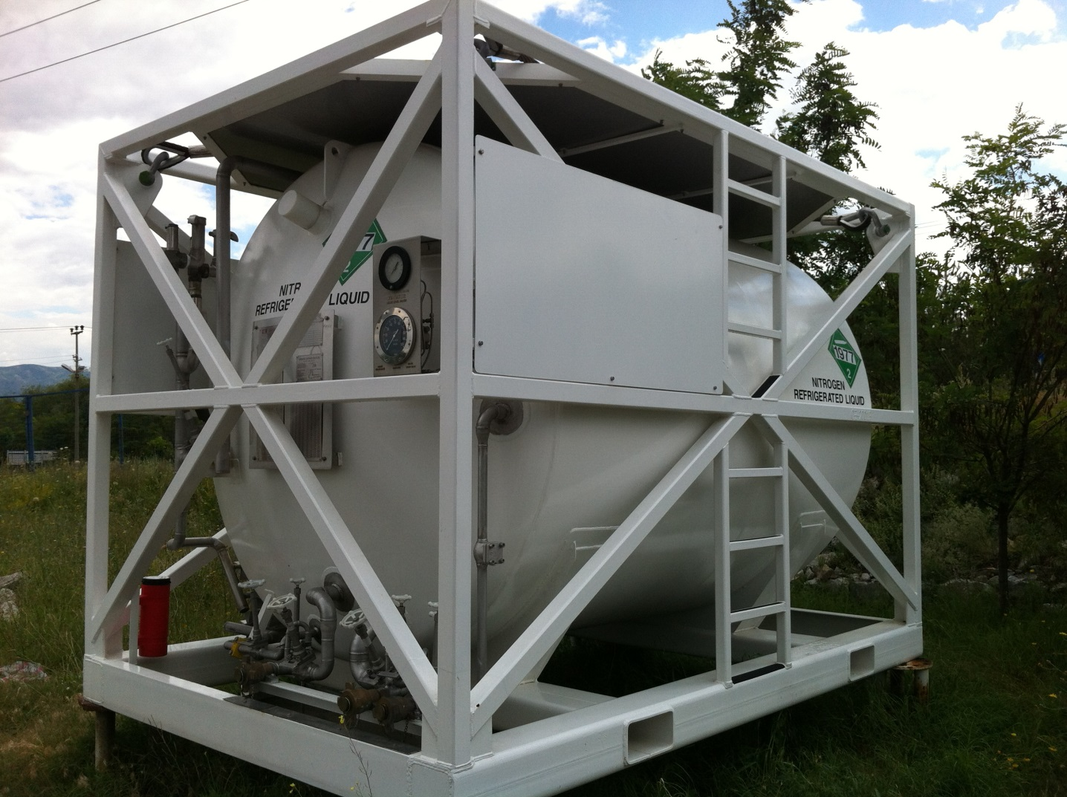

Slide 24
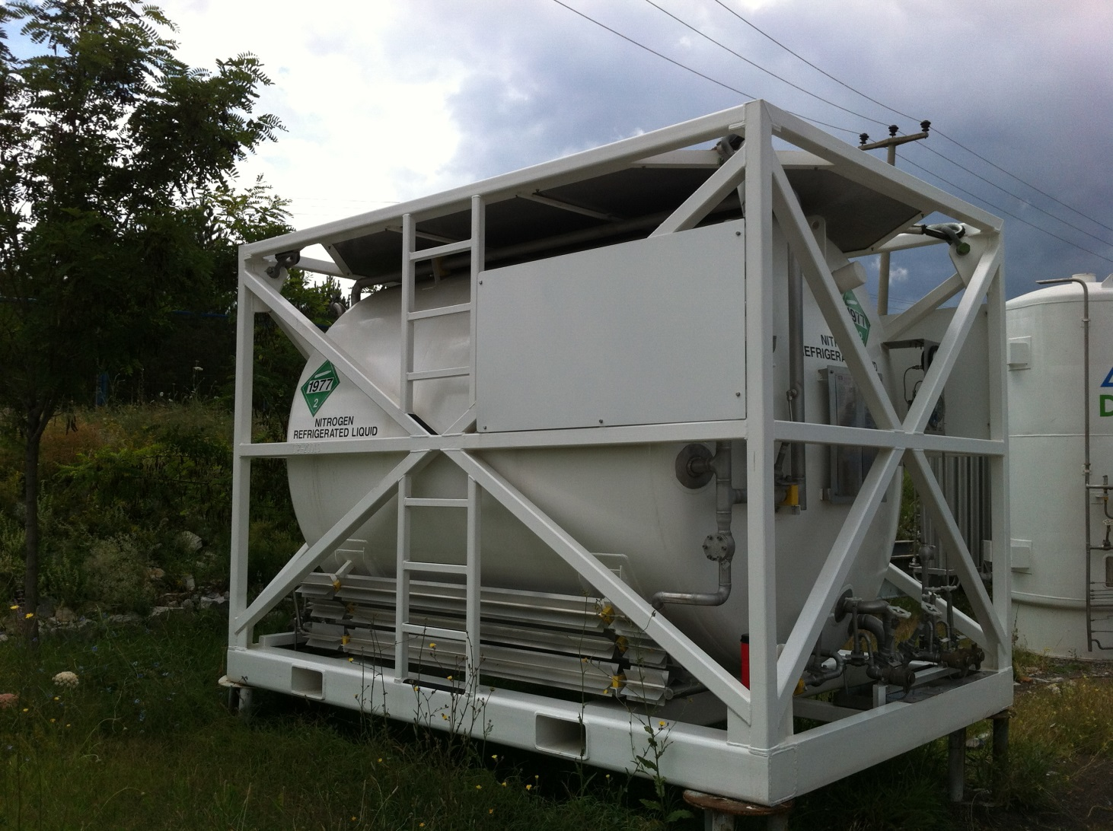

Slide 25

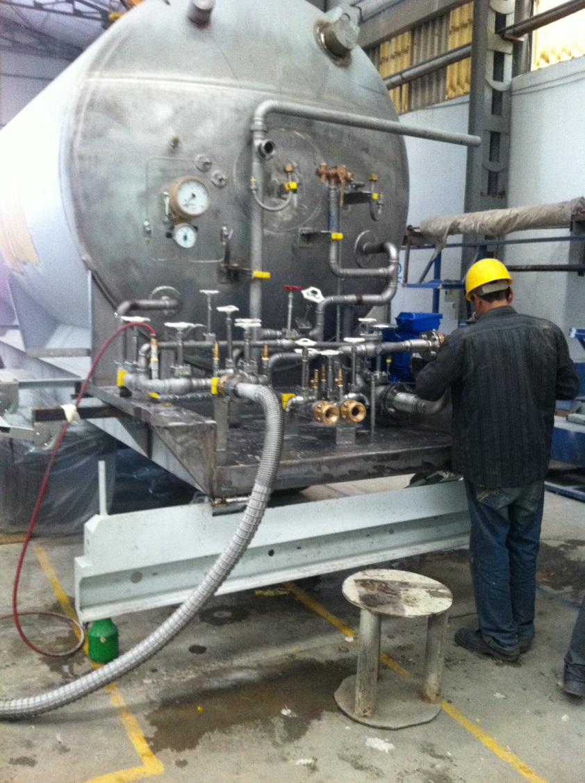
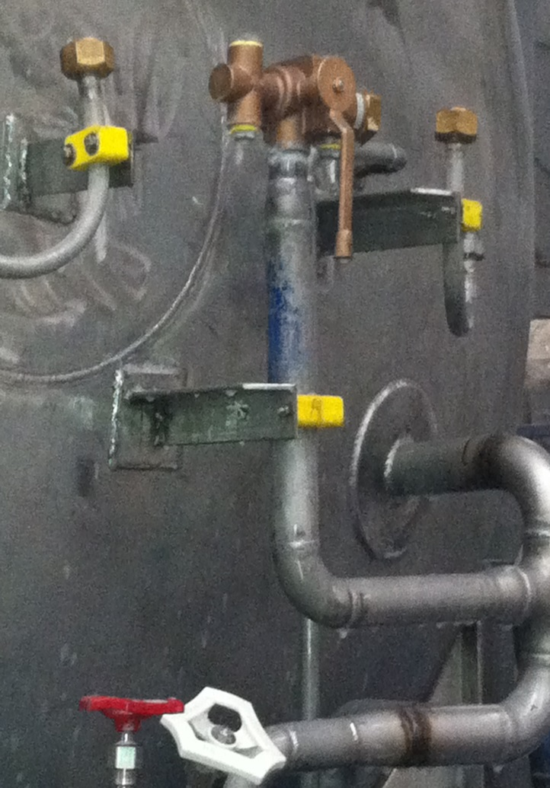

Slide 26

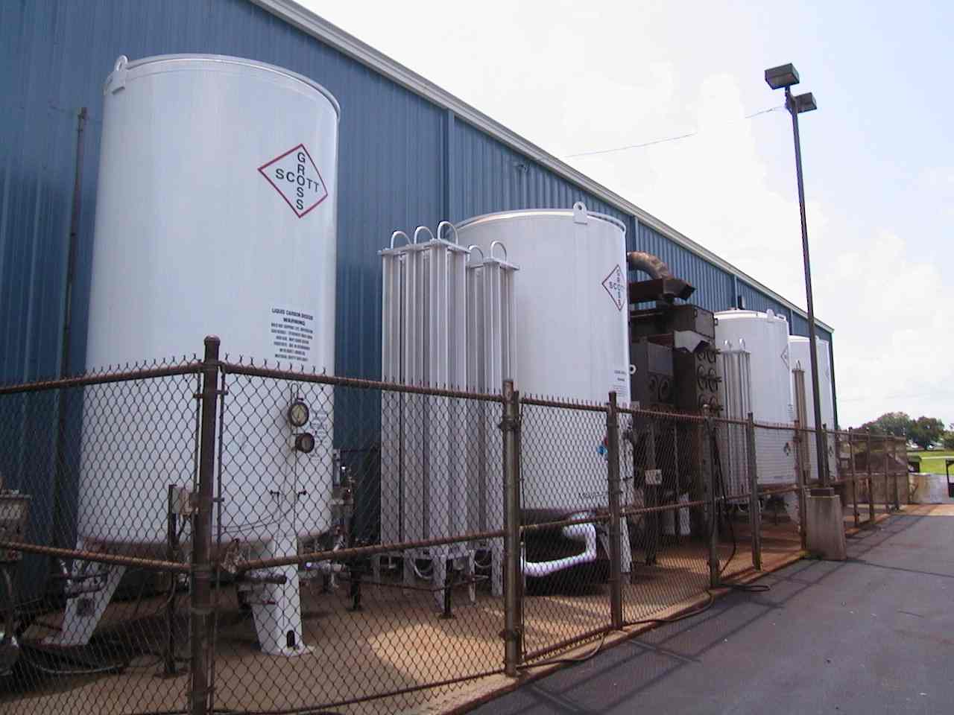

Slide 27

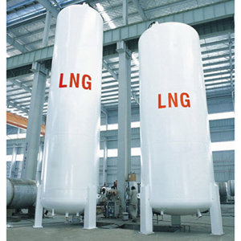
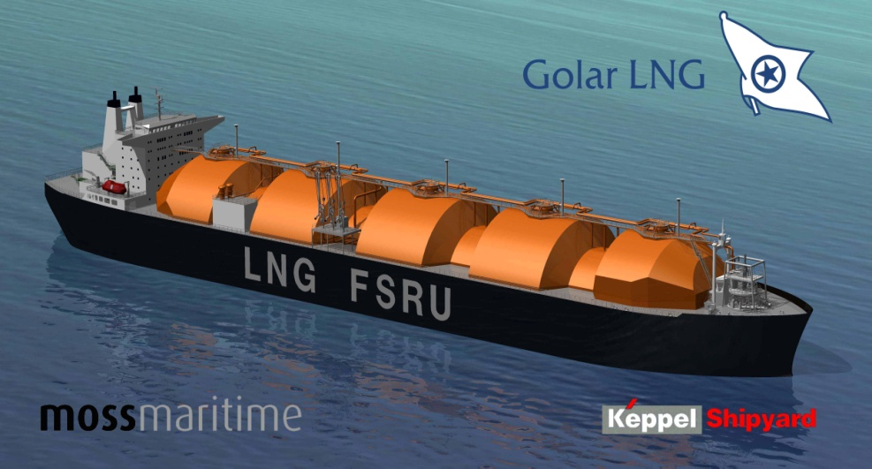
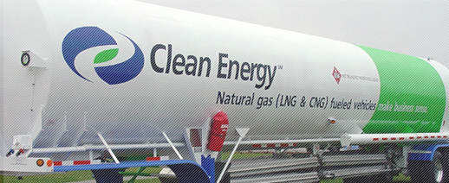

Slide 28

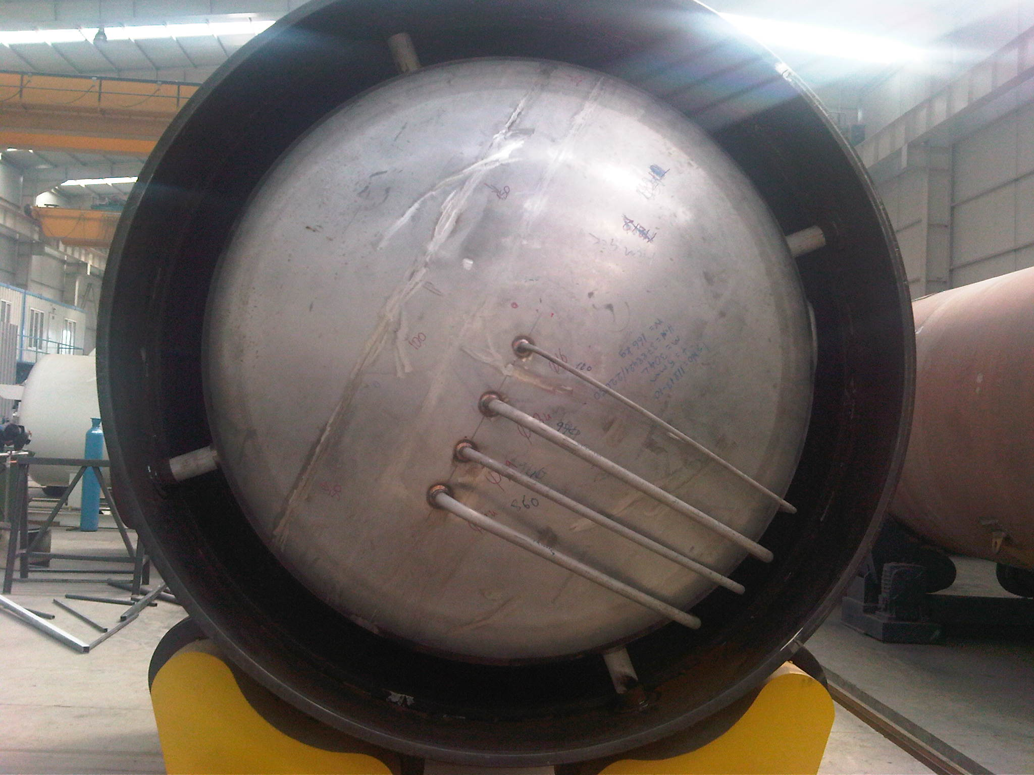

Slide 29

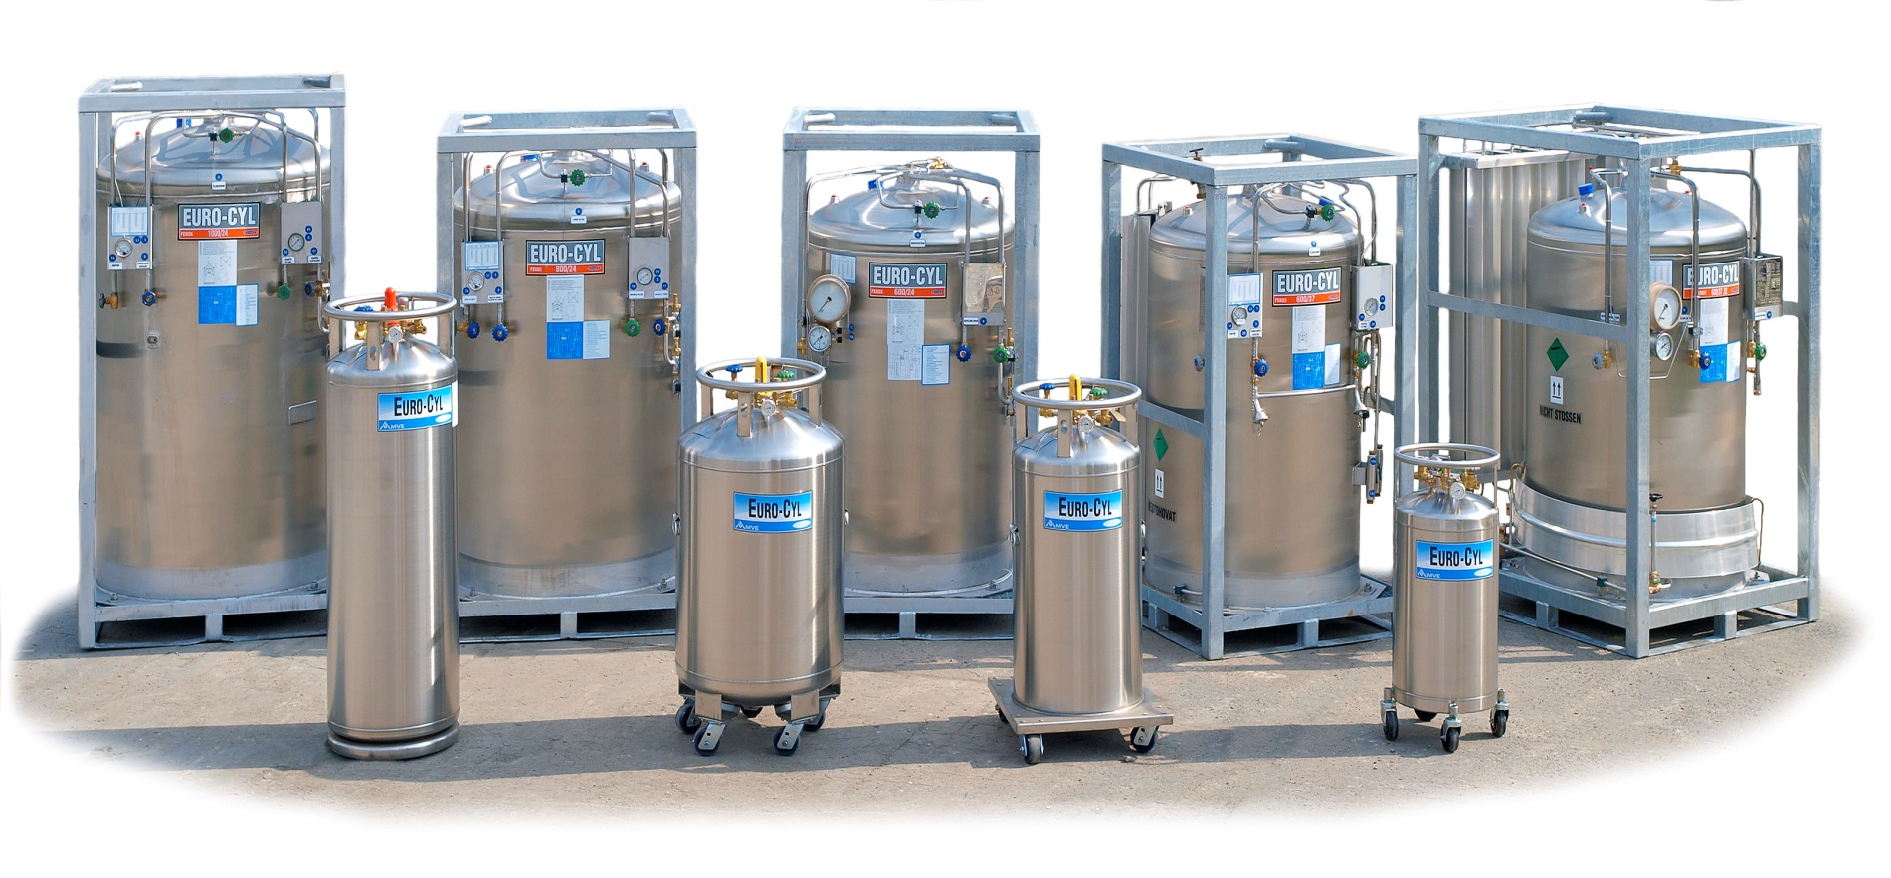

Slide 30

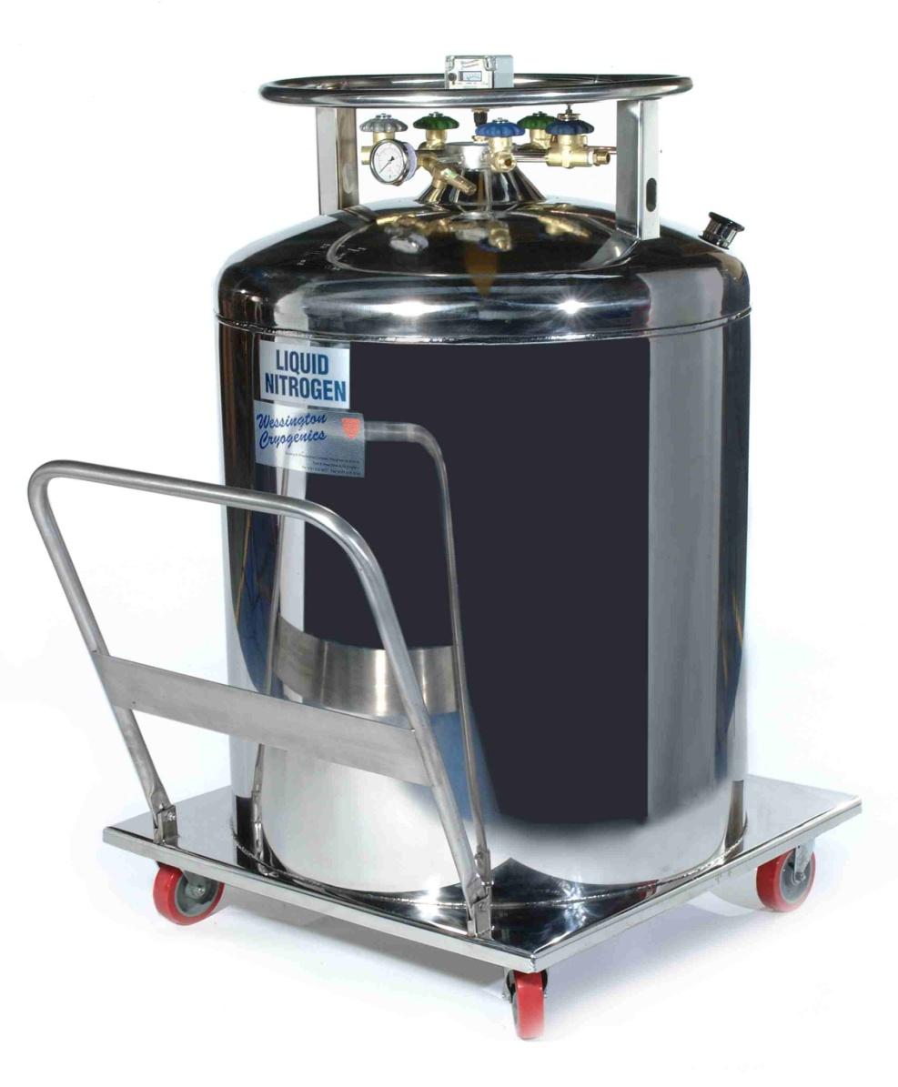
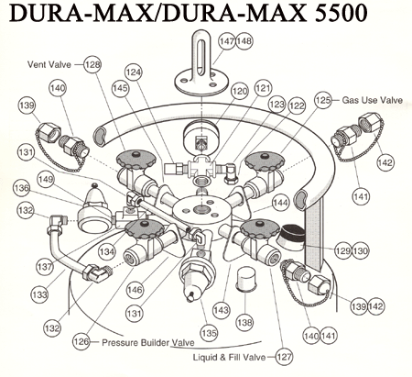

Slide 31

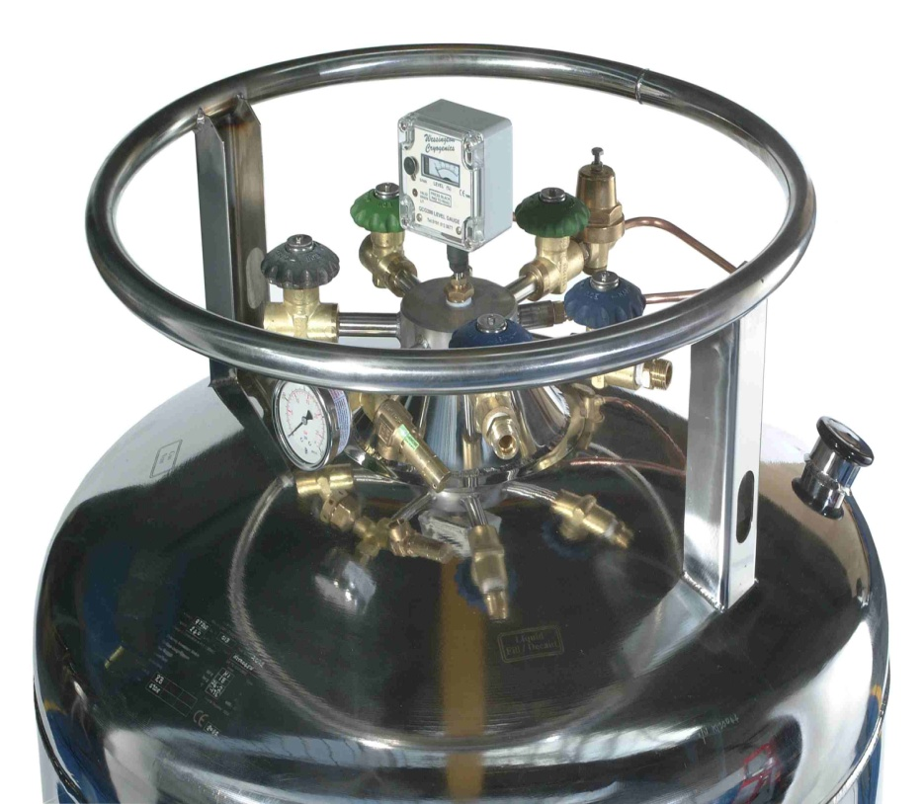
T009450 short stem Series
PRV9400 PRV‘S
RG Liquid Regulator Series
ECL Economizers Series
CBH Combination Pressure Build/economizer Regulator Series
CHART/HARSCO

Slide 32

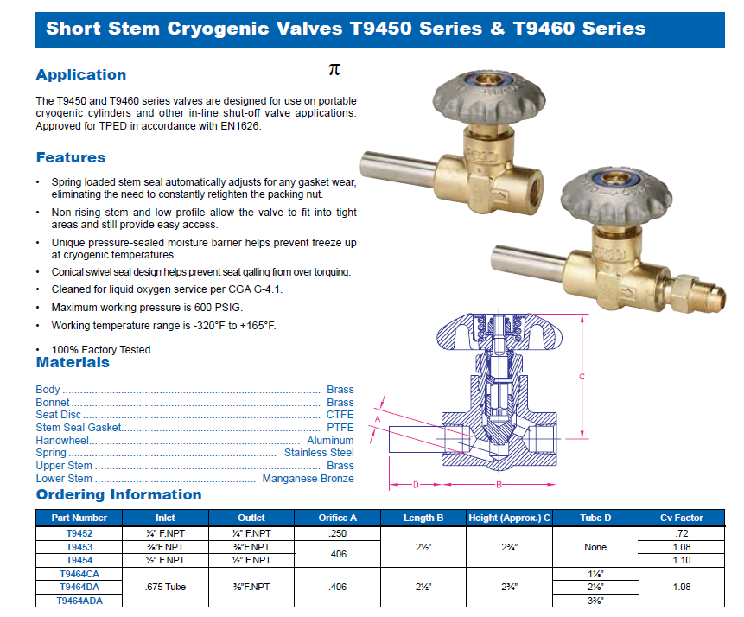

Slide 33
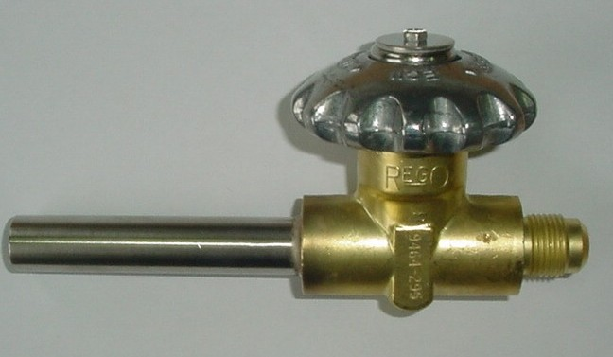
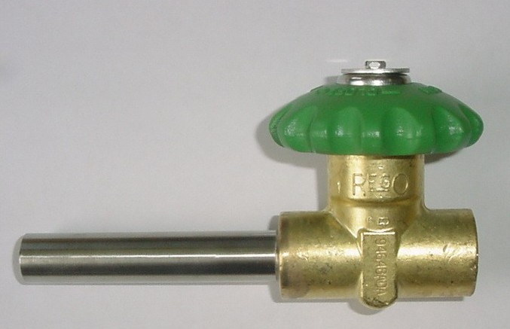
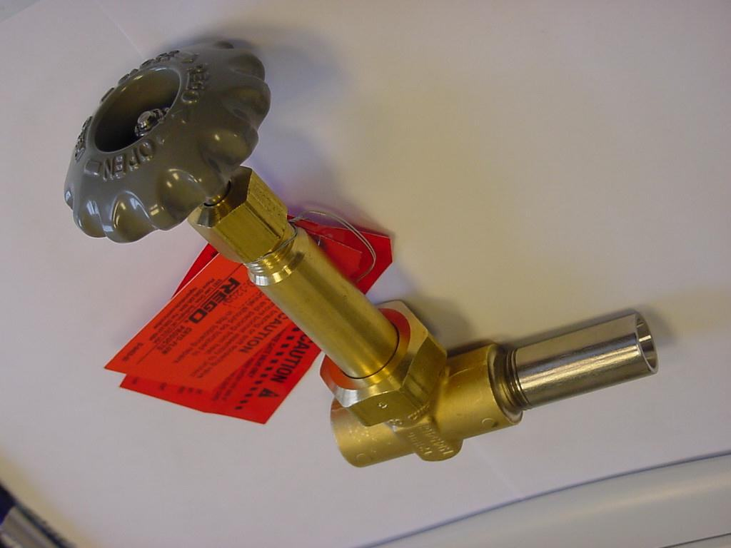
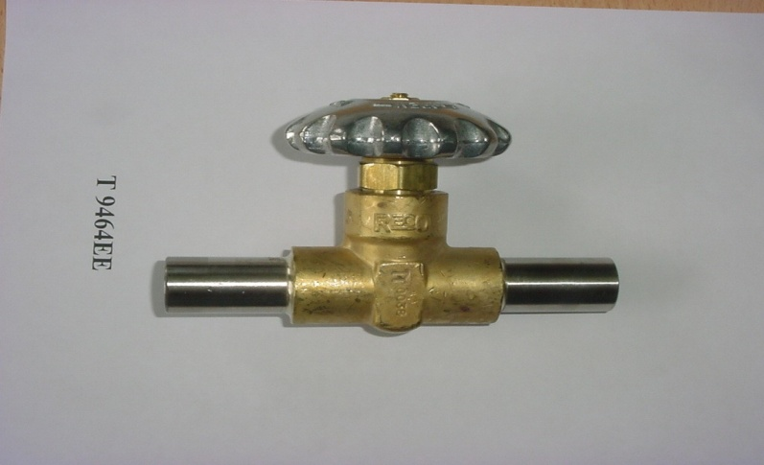

Slide 34


Repair Kit T009460-80 für T9450 und T9460 Series

Slide 35

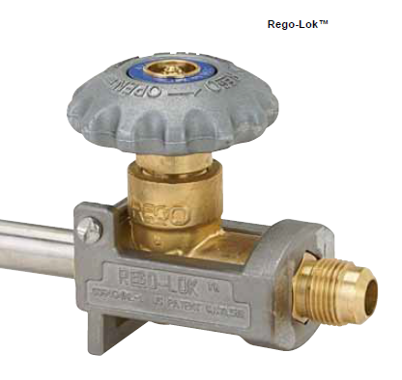

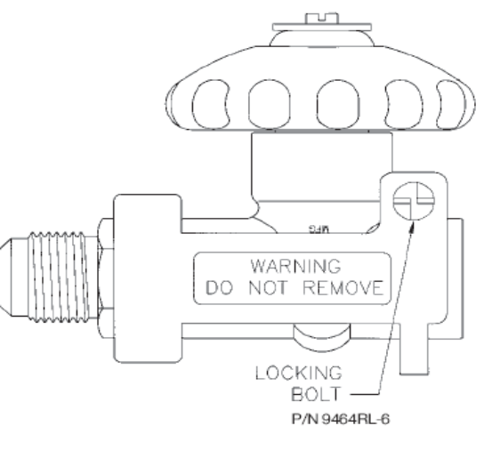
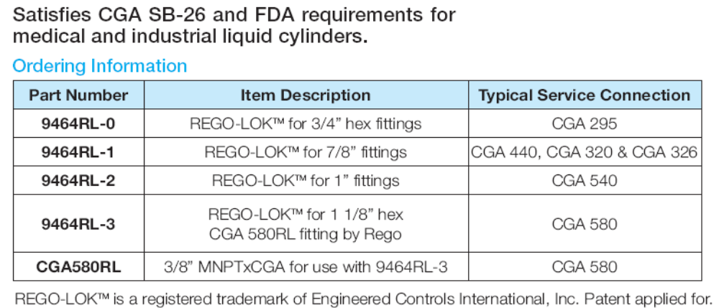

Slide 36

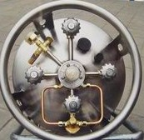
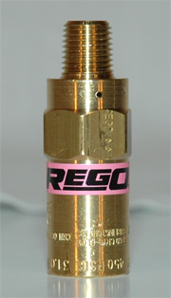
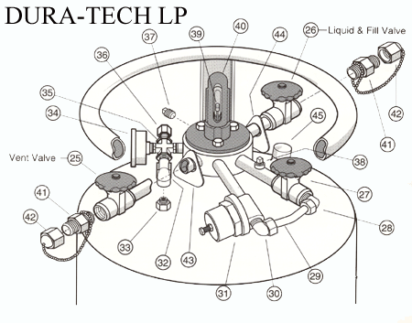

PRV9400 Serie 1/4“ , 3/8“, 1/2“ 1“
Pressure Setting 0,7 - 40 Bar

Slide 37

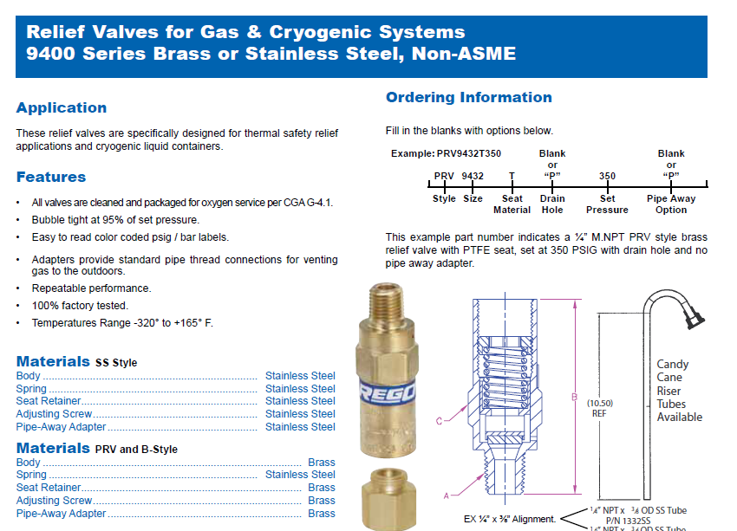

Slide 38



Slide 39



Slide 40



Slide 41



Slide 42



The same EQUIPMENT
T009450 T9460 short stem Series
PRV9400 PRV‘S
RG Liquid Regulator Series
ECL Economizers Series
CBH Combination Pressure Build/economizer Regulator Series

Slide 43






Slide 44






1
2
3
4

Slide 45




Slide 46






Slide 47




Slide 48








Slide 49




Slide 50



Slide 51



Slide 52



Slide 53


Slide 54




Slide 55






Slide 56




BR-1780 und 1780 Serie

Slide 57



Slide 58


Slide 59


Slide 60
LNG – Liquefied Natural Gas
LNG is natural gas that has been cooled down to the boiling point when it condenses to a liquid phase.
Basic characteristics:
LNG has a methane content of more than 75% and a nitrogen content of less than 5%.
Boiling temperature
It varies depending upon natural gas composition. Pure methane condenses at minus 161°C at atmospheric pressure.
Colorless
The volume of 1 Liter liquid produces approx. 600 volumes of gas.
One normal cubic meter of natural gas is generated by approx. 1,7 liters of liquid.

Slide 61
• Source of LNG , the major portions are converted to gas and transported via pipelines. However, in some cases there are reasons, to build local liquefiers.
• Liquefier storage tanks, ensure retention capacity for distribution.
• Transport vessels and vehicles, serve delivery logistics systems.
• Satellite stations, built at the gas user site or at local distribution centers.
• Vaporization systems are the majority portion of the satellite station. They convert liquefied gas back into the gase-ous phase to serve process technologies and heating systems.
• Vehicle refueling stations are a special kind of satellite station which provides refueling of vehicles operating on compressed natural gas (CNG) or on liquefied natural gas (LNG) directly onboard.
• Vehicle onboard LNG systems ensure storage and vaporization of LNG for delivery of pressurized gas to the vehicle engine.

Slide 62

LNG Drivers

Slide 63

LNG Drivers

Slide 64

LNG Drivers

Slide 65
LNG The Facts Video
http://www.youtube.com/watch?v=vh8DtjzCumE

Slide 66




LNG on Truck or Bus

Slide 67



LNG on Truck or Bus

Slide 68



Slide 69

LNG Satellite Station. Turn-Key delivered to Naturgass Vest, Norway, with storage capacity of 1 500 000 liters and delivery of 4 200 Nm3/hour, serving an aluminum foundry. NGV is a LNG whole-saler. The gas is delivered by NGV’s ship which can be seen in the background.

Slide 70


Storage tank containing 257.000 liters of LNG with a pump system for filling road trailers, located at a Gasnor LNG liquefac-tion plant in Snurrevarden, Norway.

Slide 71

Cold-box component
of a LNG liquefier
Liquefaction Technology
The process of liquefaction is based on cooling the gas to its condensation temperature –162°C, which is in the range of “cryogenic” temperatures and requires very special, highly technical designs. By transferring gas to a liquid state, this process reduces its volume nearly 600 times for simplified storage and transportation.

Slide 72



Slide 73

LNG semi-trailer with a capacity of 56 000 liters, delivered to Naturgass Vest, Norway

Slide 74


LNG Tanks Aritas Turkey

Slide 75

LNG TANK Aygaz -DOGALGAZ.

Slide 76


Natural gas is becoming one of the most important primary energy sources for the 21st century. This is due to the large reserves throughout the world and because it is a relatively clean fuel. Natural gas produces about half of the carbon dioxide compared to other fossil fuels, with very few undesirable emis-sions. Natural gas is the clean fuel of choice as it helps solve two major environmental concerns: air pollution and the greenhouse effect.

Slide 77




Slide 78


Slide 79


Slide 80







Slide 81





Slide 82







Slide 83








Slide 84


RegO CryofloW Cryogenic and Goddard Products also complete for Russia Approved

Slide 85







Slide 86







Slide 87




THANK YOU
www.rego-europe.de

